Slide 1



UNIT
3
Getting along with others

Slide 2

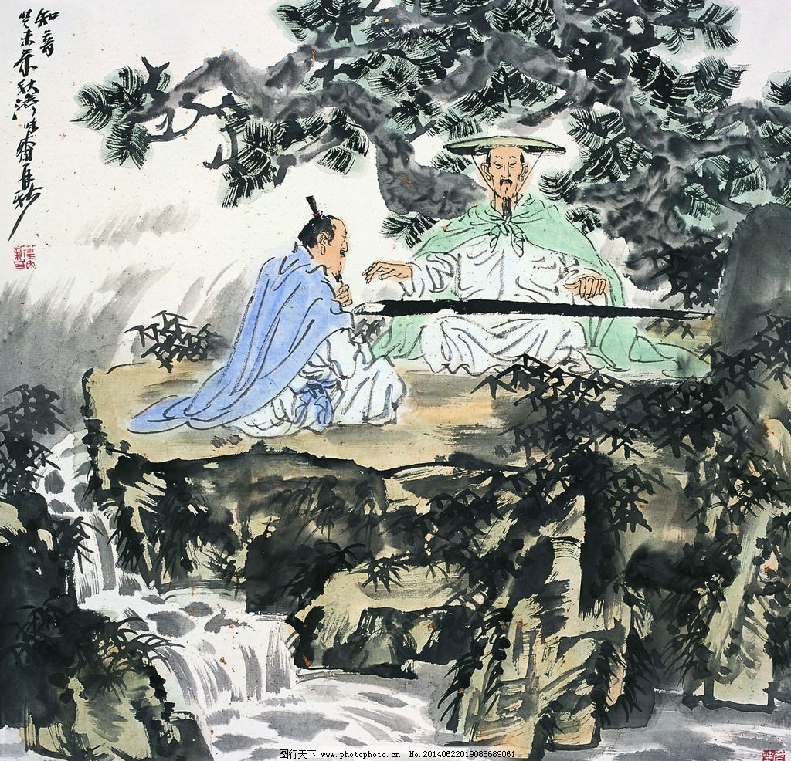
Lead-in
Who are they and how are they getting along with each other?
Friendship based on revolutionary struggles （革命斗争）
High Mountain and Flowing Water

Slide 3
Karl Marx and Friedrich Engels were good friends. Marx admired Engles and always followed his steps in pursuing a better-civilized world. Engles viewed Marx as an extraordinary talent and they devoted their life’s work to a common cause (共同的事业) -- communism(共产主义).

Slide 4
Music talent Bo Ya loved playing High Mountain and Flowing Water, which could hardly be understood by anyone but a woodcutter named Zhong Ziqi.
Bo Ya cherished（珍惜） this friend who could understand his music and his mood and thoughts as well. When he heard that Ziqi died, Bo Ya thought no one could appreciate（欣赏） his music, so he smashed（砸碎） his zither(琴) and never played again.

Slide 5
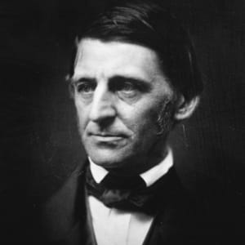
A quotation about friendship
The glory of friendship is not the outstretched hand, nor the kindly smile, nor the joy of companionship; it's the spiritual inspiration that comes to one when he discovers that someone else believes in him and is willing to trust him.
--- Ralph Waldo Emerson
友谊的光辉并不在于伸出的援手或者善意的微笑，也不在于陪伴时的快乐。它是当一个人发现有人相信他并愿意信任他时得到的精神鼓励。
An American Transcendentalist(超验主义) poet, philosopher（哲学家） and essayist（散文家） during the 19th century. One of his best-known essays is "Self-Reliance.”《论自助》

Slide 6
Welcome to the unit
Teenagers may have difficulty maintaining their friendship. Watch the video and finish the following exercises.
Bill’s problem:
_______________________
Jane’s problem:
_______________________
Harry’s problem:
_______________________

Slide 7
Bill's problem:
same
We are at the __________ high school, but things have changed: We no longer share the same _________.
interests
Jane's problem:
different
miss
We are at __________ high schools, and I ______ my best friend from junior high.
Harry's problem:
I have every hope of ________ ________with the other boys. But, I dare not. I’m ________ they don’t like me
making
friends
afraid

Slide 8
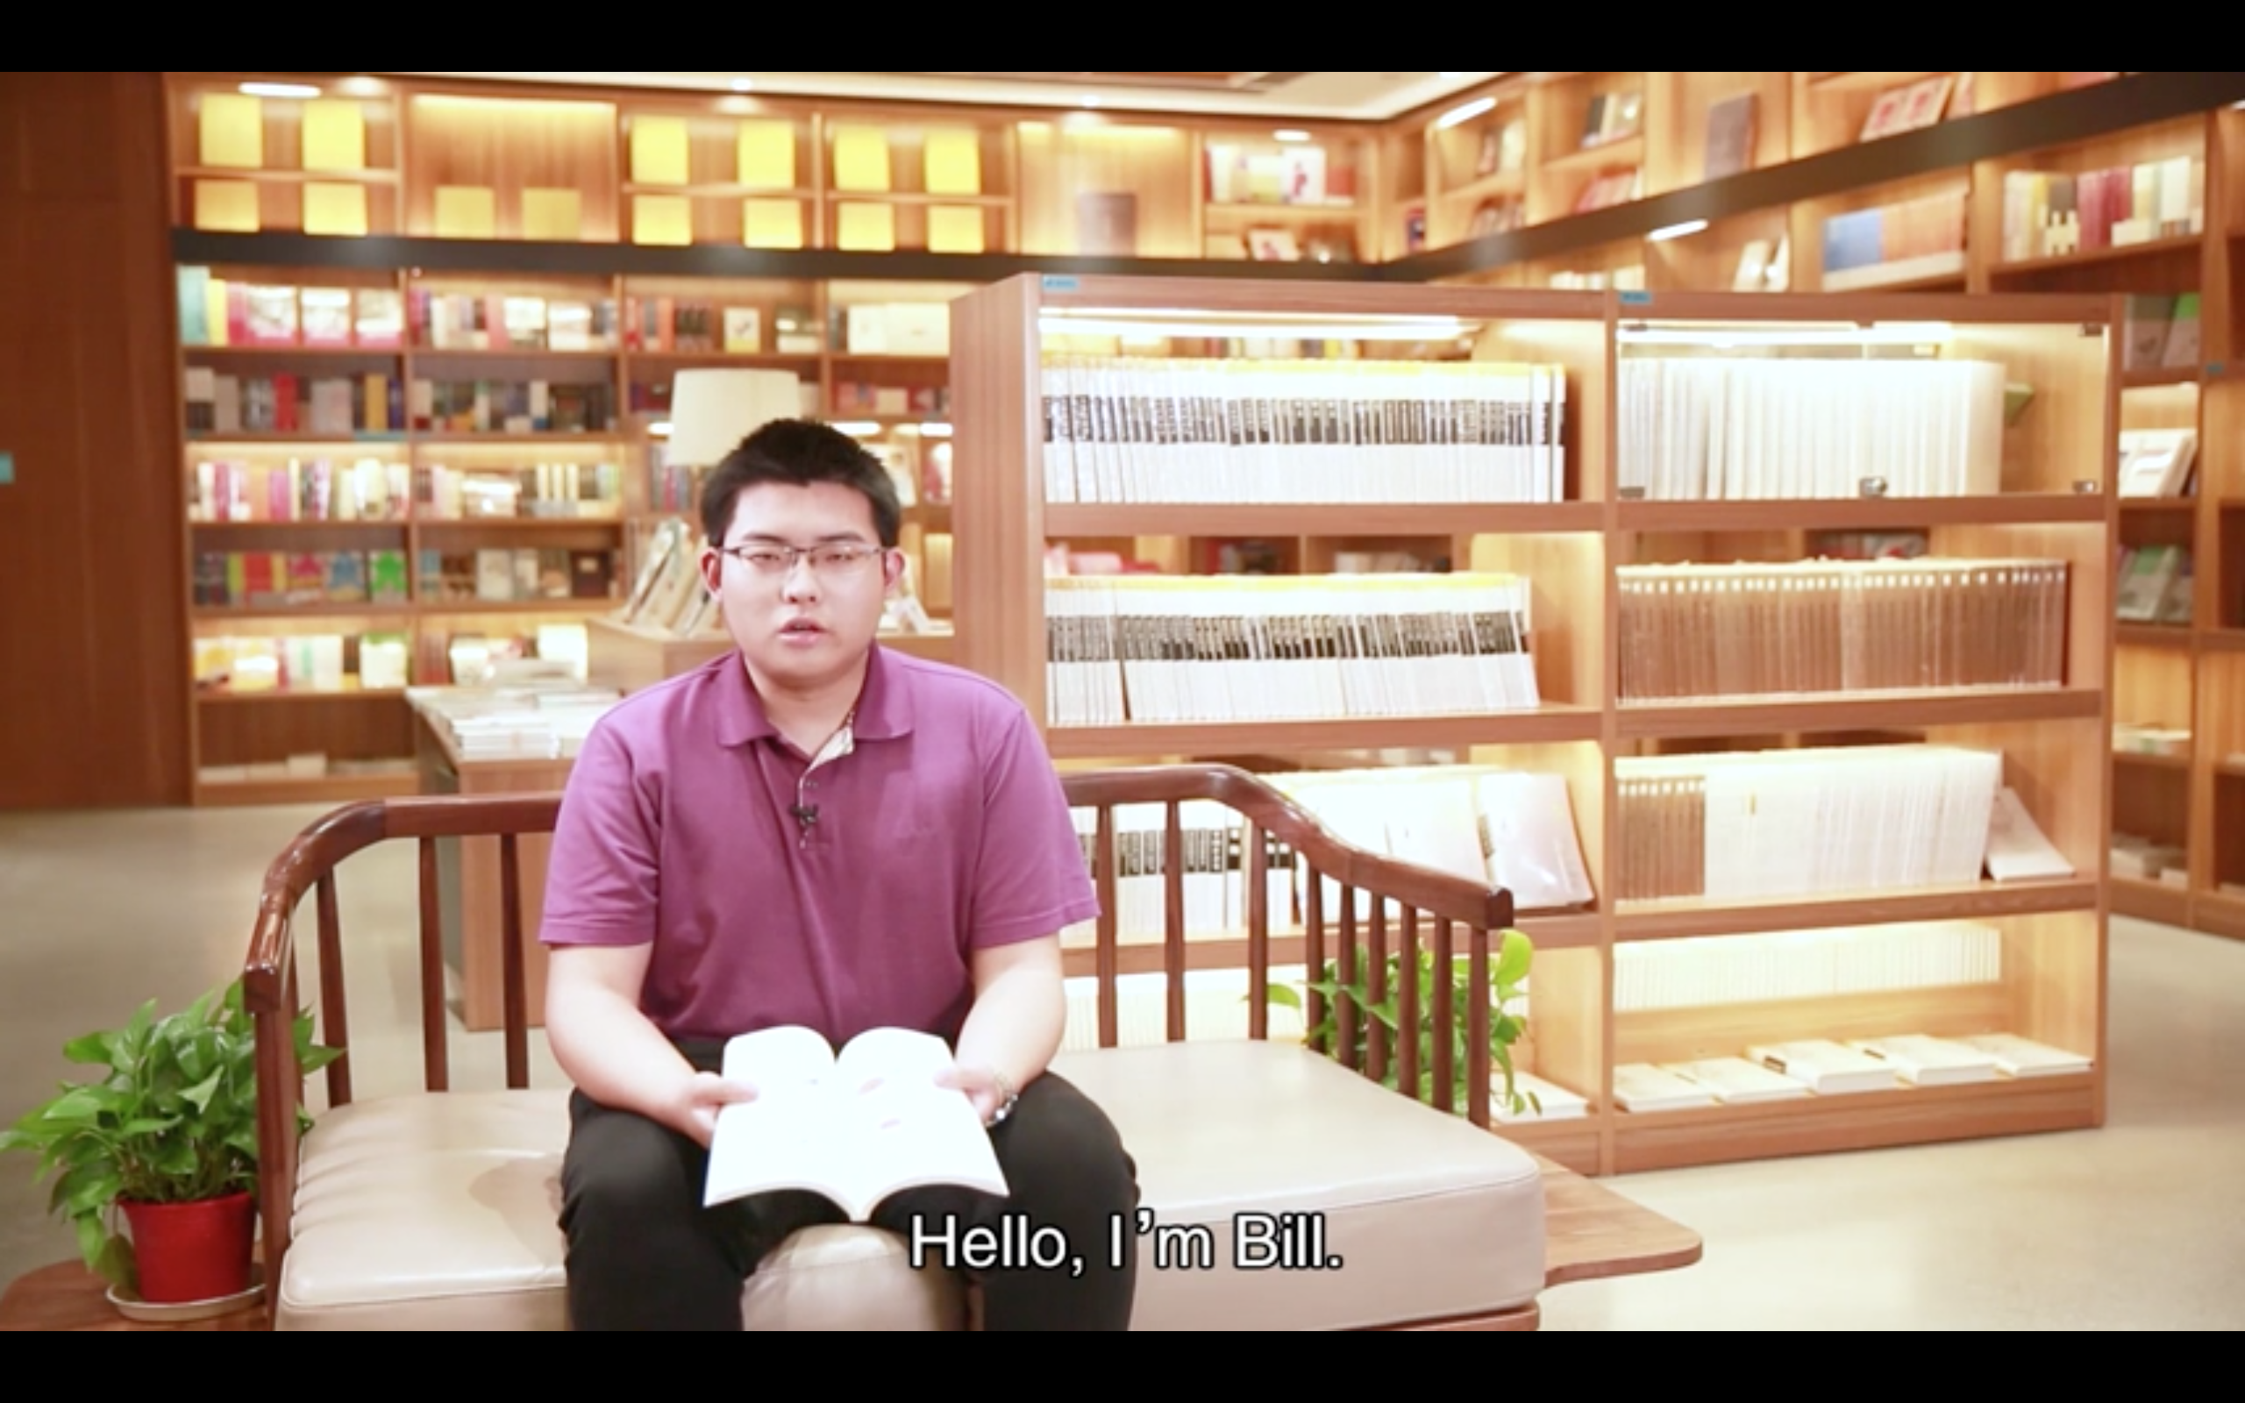
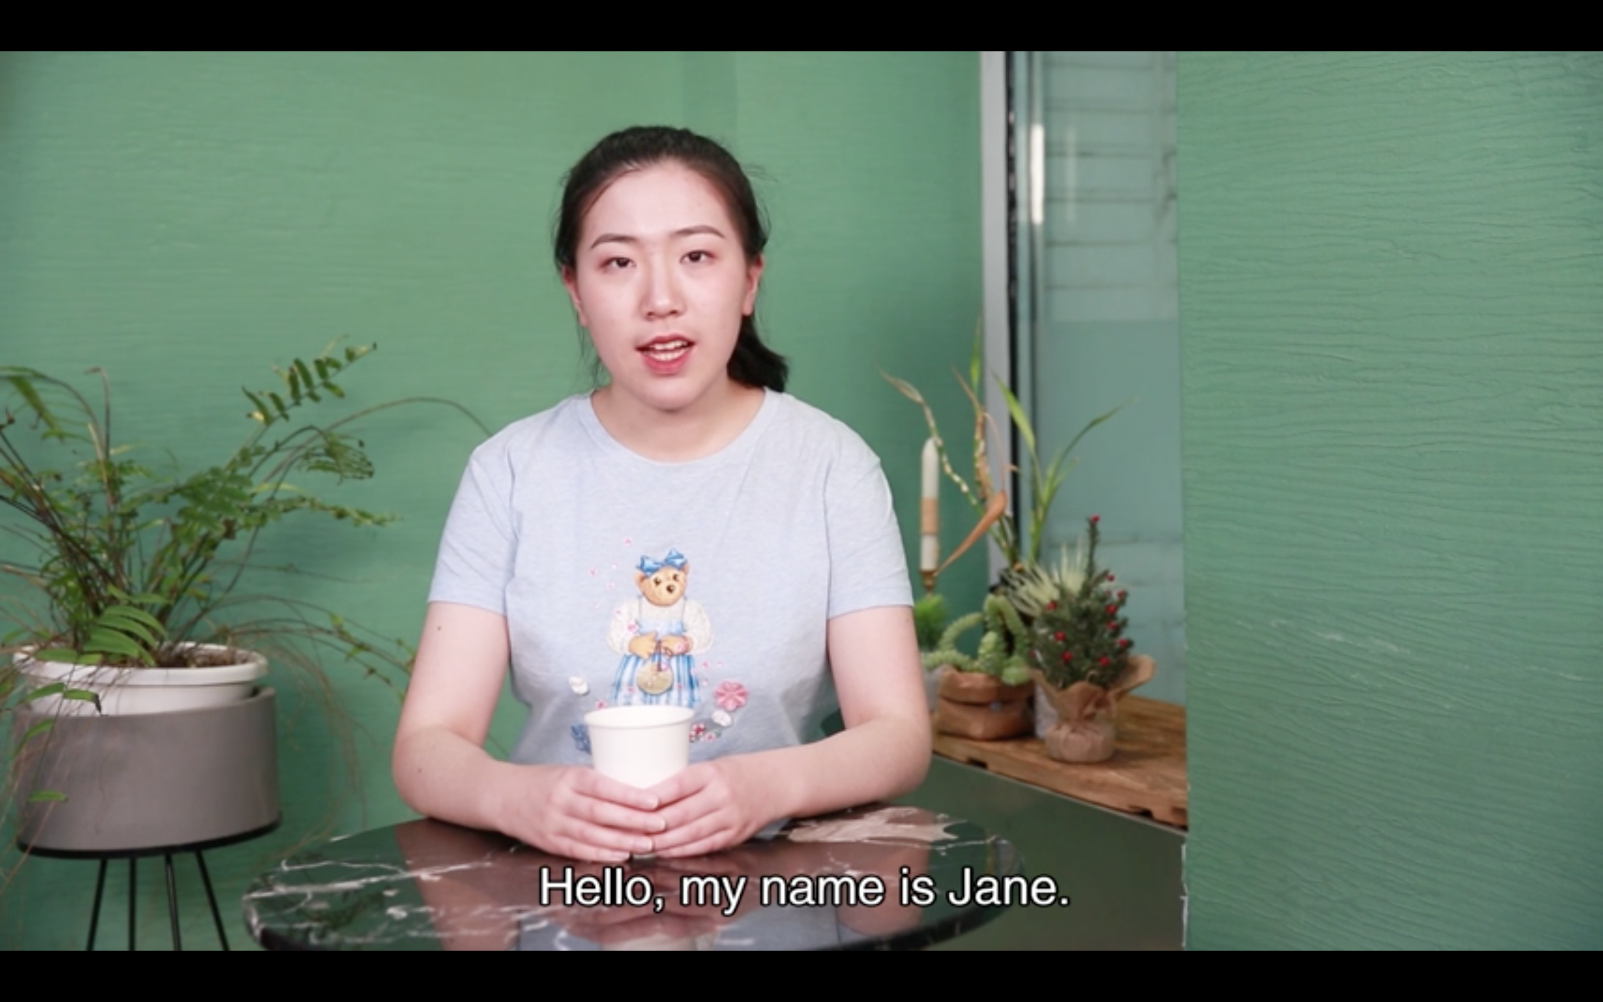
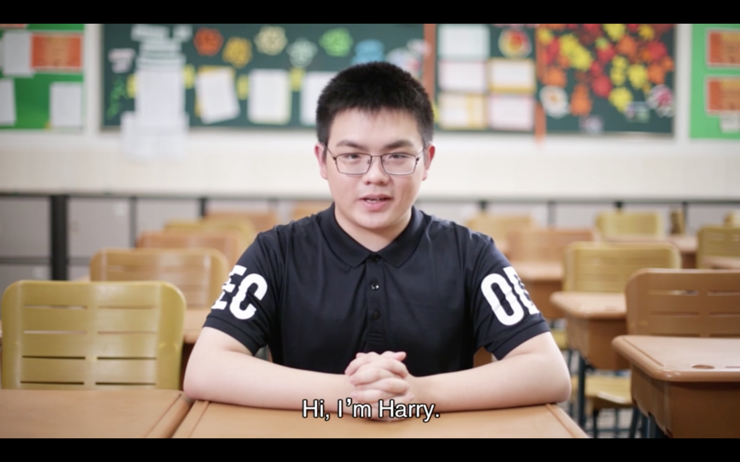
Bill’s problem:
Bill and his best friend do not share the same interests now.
Jane’s problem:
Jane misses her best friend from junior high school.
Harry’s problem:
Harry is too shy to make friends with the other boys in his class.

Slide 9

What advice can you give to these teenagers?

Slide 10
Bill and his best friend do not share the same interests now.
Suggestions for Bill:
He can _________ his friend about this problem first. If his friend also feels the same, perhaps it is time to _________their friendship and let go of it.
talk to
rethink

Slide 11
Jane misses her best friend from junior high school.
Suggestions for Jane:
She can keep in touch with her friend on ___________. She can also pick a day to meet her friend in person.
social media

Slide 12
Harry is too shy to make friends with the other boys in his class.
Suggestions for Harry:
He needs to be ________ enough to be the first to say hi to his classmates. Then he will find they are friendly and a friendship may naturally grow.
brave

Slide 13
Lead in
Let’s play a game!
Stand up & Sit down
Stand up if you have at least one friend.
Sit down if ...
you have broken up with your friend.
you have had an argument with your friend.
you have been angry with your friend.

Slide 14
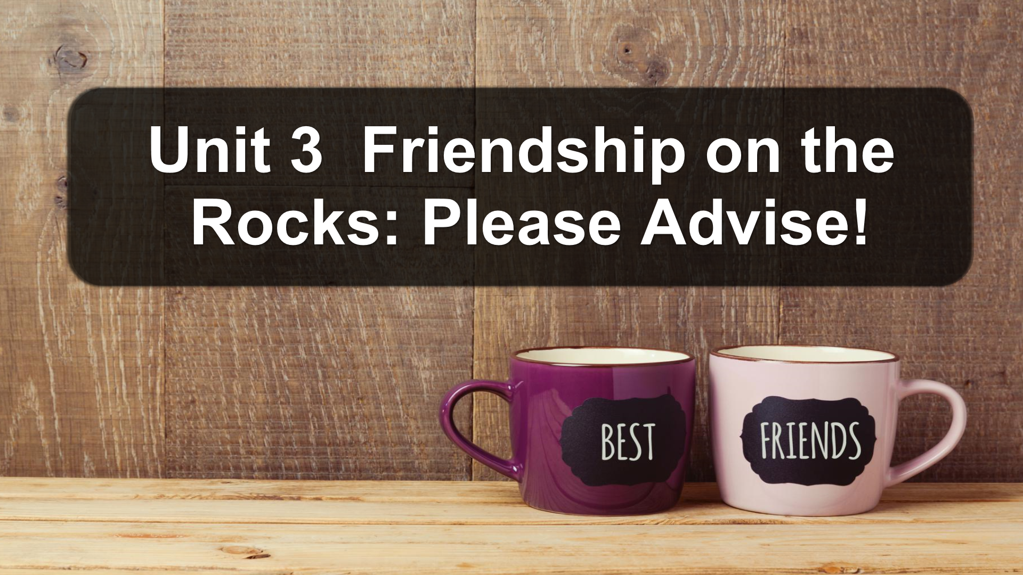

Slide 15
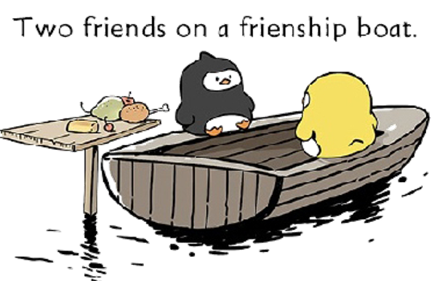
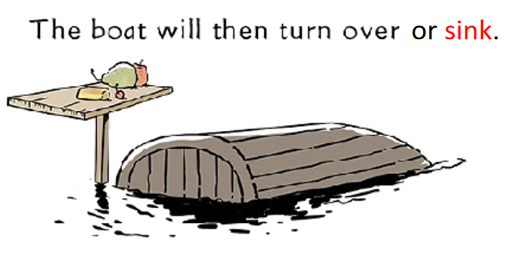
lies
indifference
betrayal
misunderstanding
What makes your friendship on the rocks?

Slide 16

What qualities should a good friend have?
I think a friend should be kind/patient/generous…

Slide 17
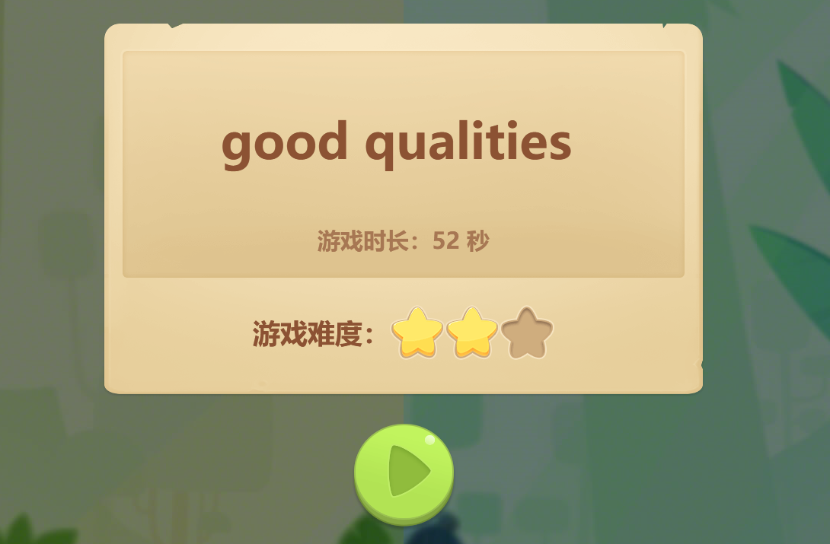
Words Flash!
Are you ready?

Slide 18
humorous
approachable
helpful
honest
respectful
thoughtful
frank
generous

Slide 19

dishonest
selfish
May have difficulty in maintaining your friendships
Cause problems

Slide 20
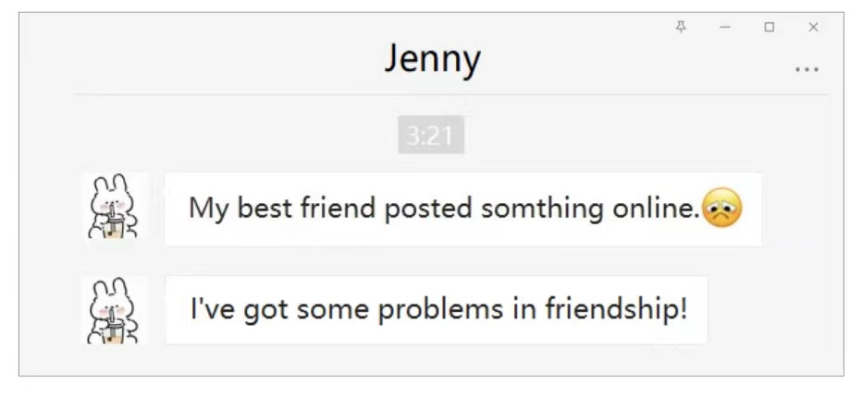
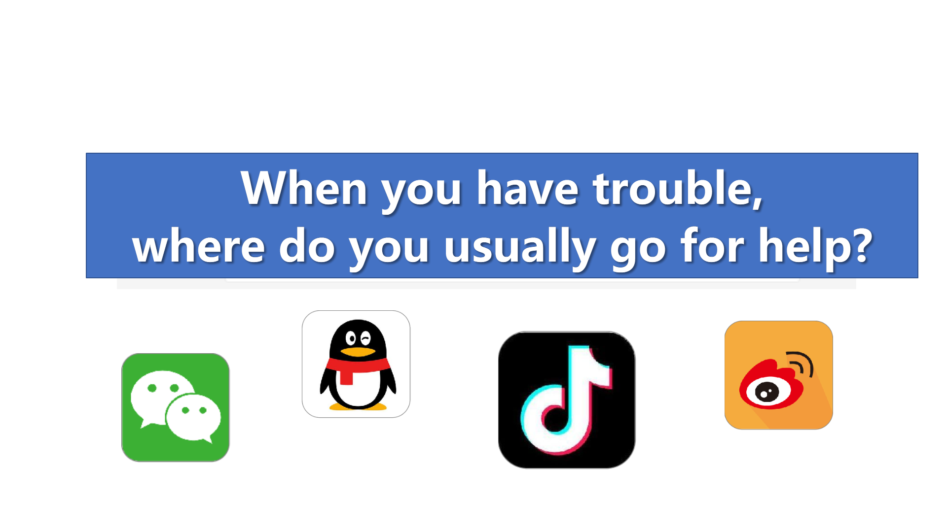
When you have trouble, where do you usually go for help?

Slide 21
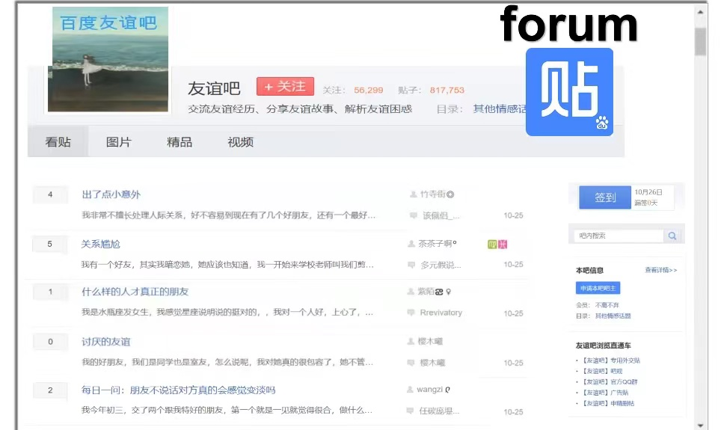
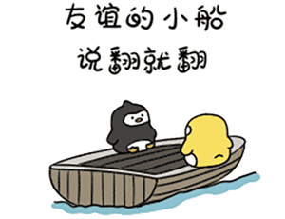
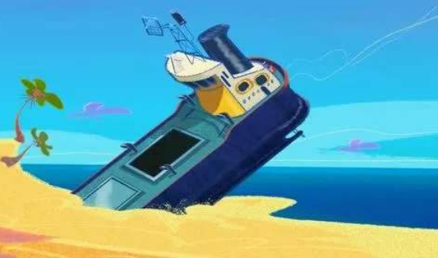
The post of Jenny’s friend:
Friendship on the rocks: please advise!
It means that friendship may be in trouble.

Slide 22
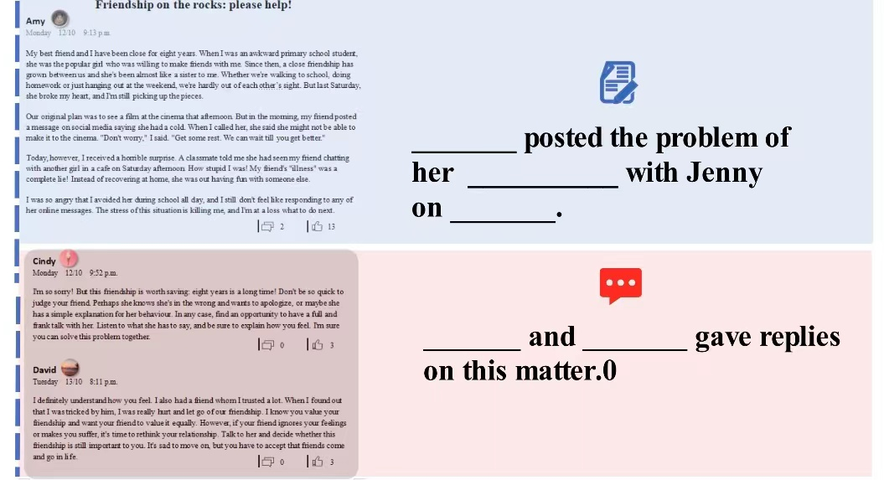
Task 1
Fast reading
Amy
who
friendship
what
Monday
when
Cindy
David

Slide 23
Task 2
Reading for details.
What exactly happened to Amy?

Slide 24
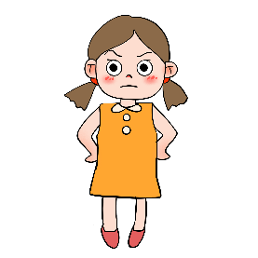


Amy：an ______ student
What exactly happened to Amy?
Last Saturday
they planned to _________
Jenny posted a message saying she ___________
Amy's classmate told her that Jenny was _________ with another girl
Amy felt ______ and she is ____________what to do next.
see a film
awkward
had a cold
a close ________
friendship
a sister
chatting
Jenny：a ______ girl
popular
angry
at a loss

Slide 25
A1 Amy’s problem（P32）
u
Saturday morning:
Amy’s friend said she was ill and might not be able to make it to the cinema.
v
Saturday afternoon:
⁽¹⁾
Amy’s friend was out having fun with someone else.
w
Monday:
⁽²⁾
Amy received a horrible surprise.

Slide 26
If you were Amy,
what would you do?
2 points
If I were Amy, I would rethink our relationship.
If I were Amy, I would find a chance to have a full communication with her.
…

Slide 27
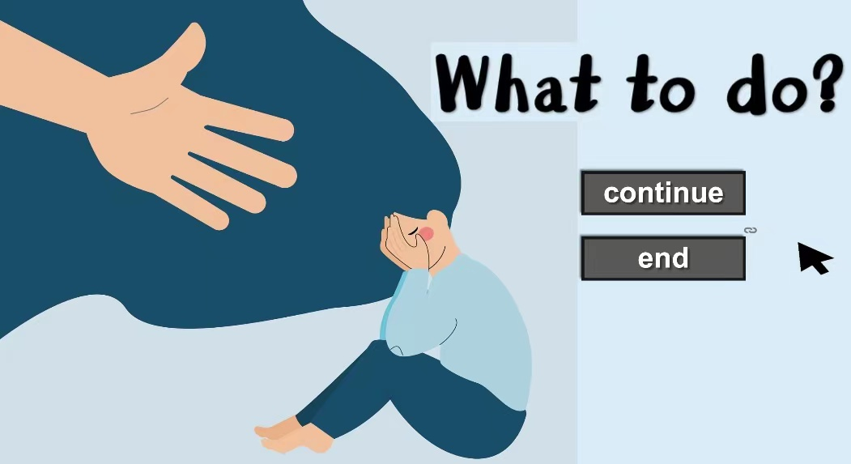

Slide 28
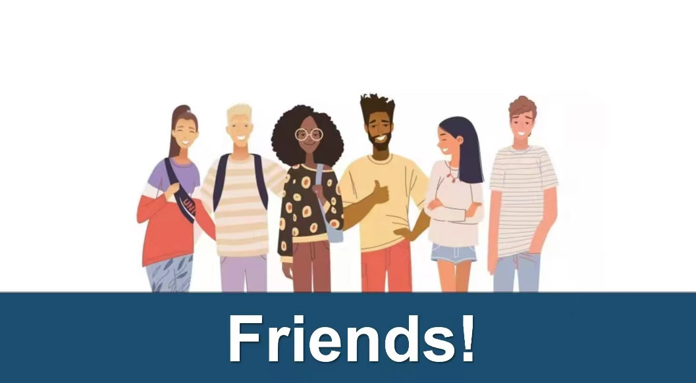
Now let’s see what are the pieces of advice from Cindy and David?

Slide 29
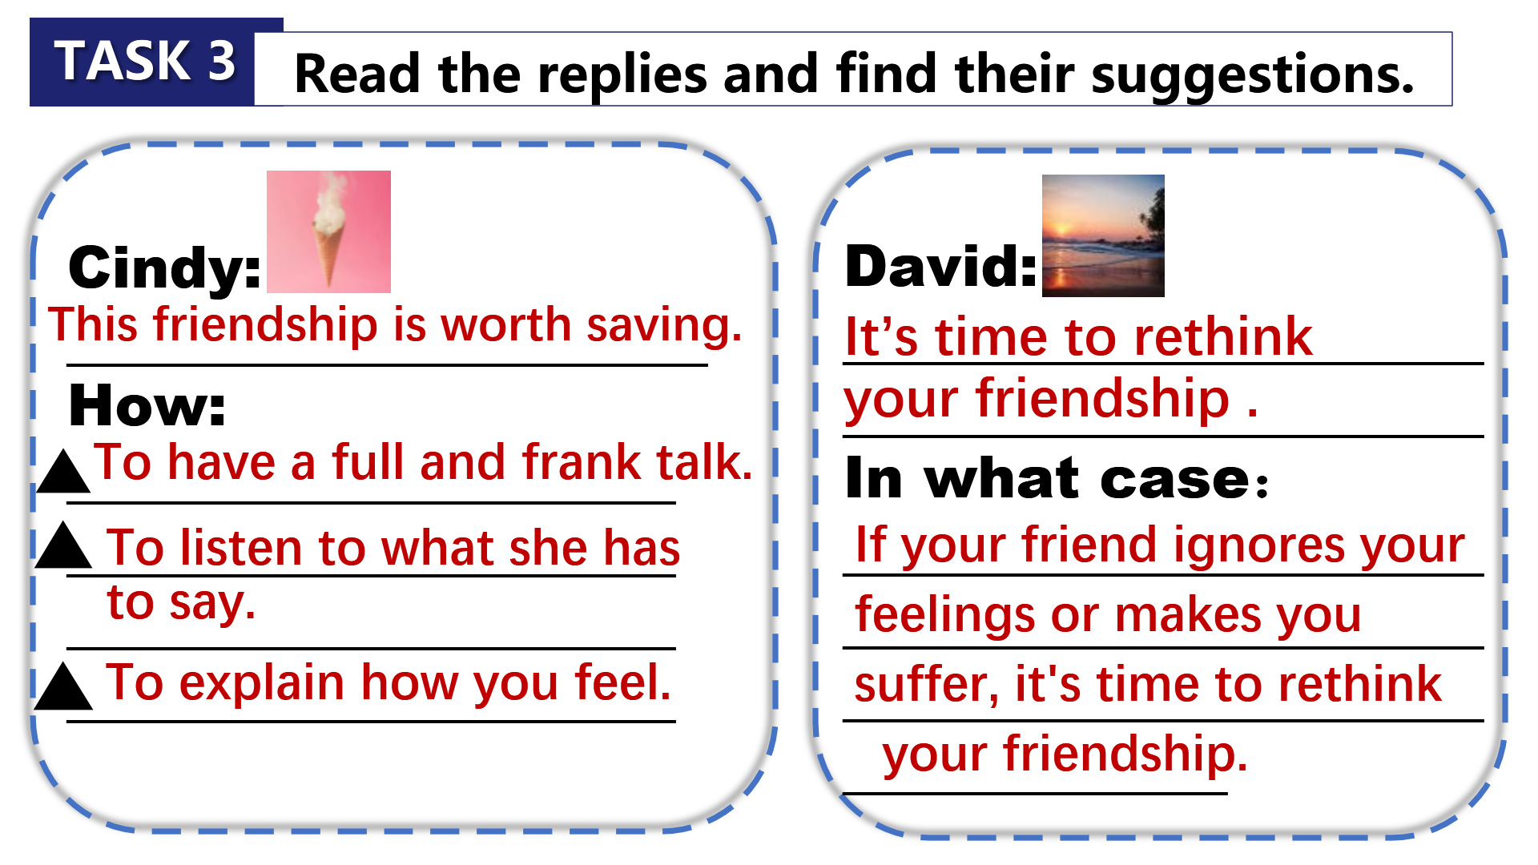

Task 3
Read the replies and find their suggestions.（P32）
2mins to find out the details.
Cindy：
Cindy：
This friendship is worth saving.
How：
To have a full and frank talk.
To listen to what she has to say.
To explain how you feel.

Slide 30
Task 3
Read the replies and find their suggestions.
David：
It’s your time to rethink your relationship.
How：
If your friend ignores your feelings or makes you suffer, it’s time to rethink your relationship.

Slide 31
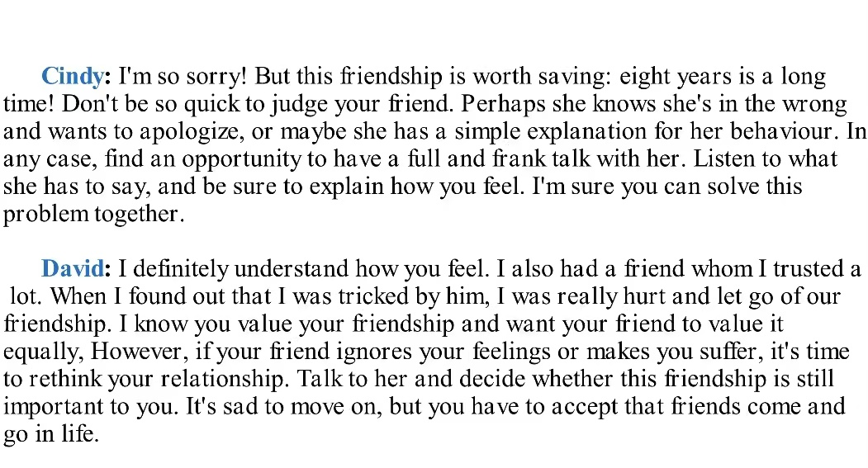
Task 4
Understanding
Attitude
Suggestions
Comfort
Find their similarities in structures.

Slide 32
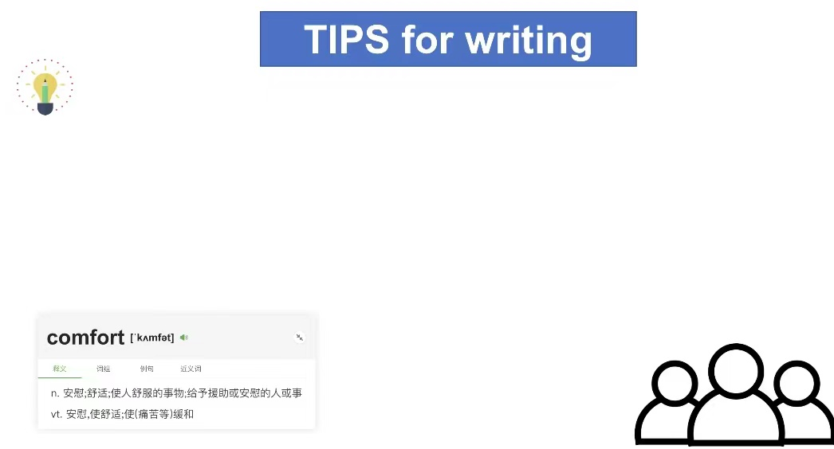
If you need to give advice to someone, you should：
let him know that you understand his feeling
show your attitude to this matter
give some useful suggestions
comfort him again and make him believe it’ll be ok

Slide 33
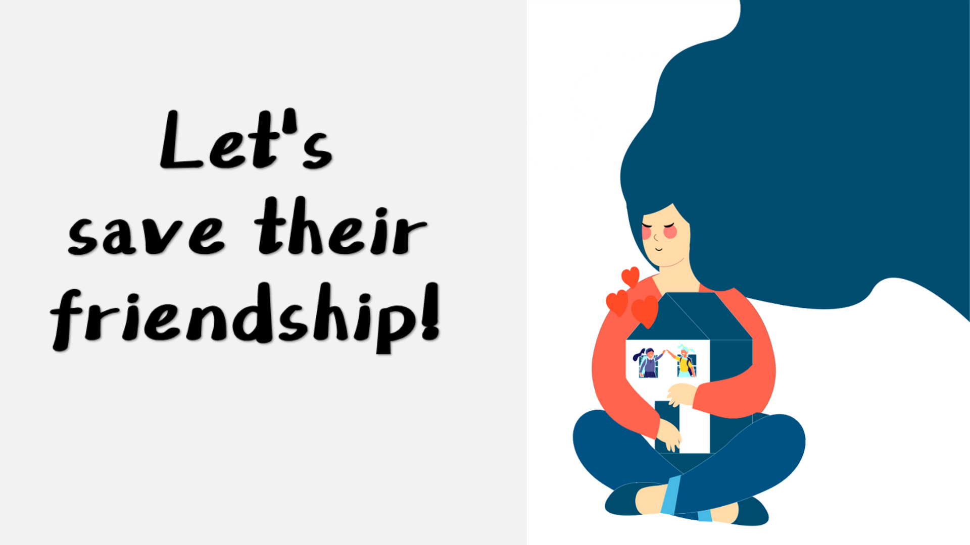
Let’s
save their friendship!

Slide 34
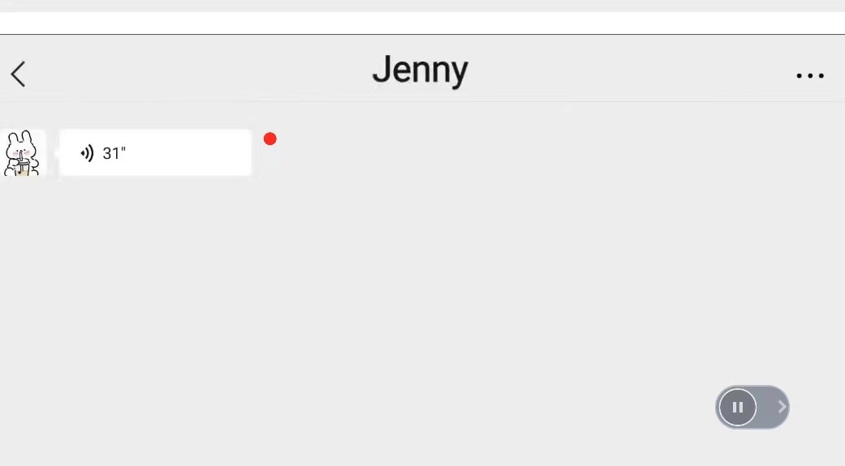
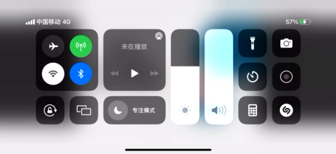
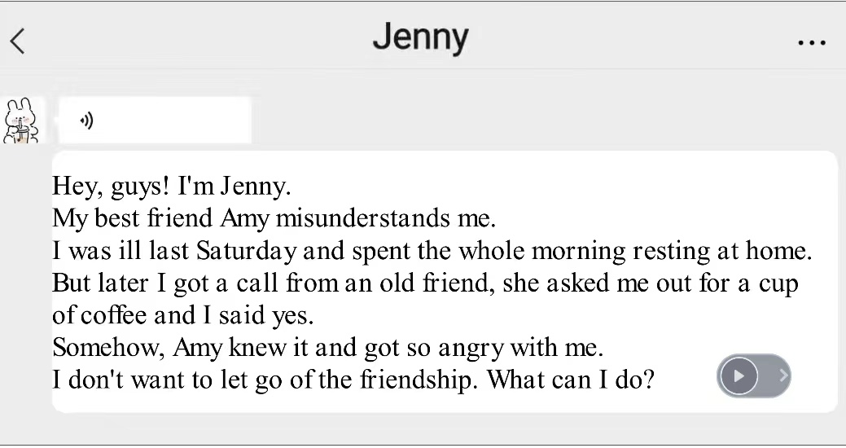

Slide 36

What do you want to say to Jenny?

Slide 37
Task 5
3 points
Prepare a message to Jenny.
Requirements:  Your writing should be about 25-50 words.
⬧ Try to use the 4 tips mentioned just now.
Understanding
Attitude
Suggestions
Comfort
I completely understand your feelings. I know you cherish your friendship with Amy and don’t want to let go of it.
————————————————————————————————————————————————————————————————————————————————————————————————————————————————————————————————————————————————————————————————
And I see eye to eye with you on saving the
friendship because eight years is a long time.
Find a chance to chat with her
I am sure Amy will
and have a simple explanation to Amy for your behavior.
forgive you and both of you will make up in time.

